Slide 1
Analysis of Deep Learning-based Object Detection: A Survey
Monica Dommaraju
San Jose State University

Slide 2
Introduction
Object detection has become more popular as it is used in various applications in the real world such as monitoring security, autonomous driving, transportation surveillance, face detection and so on.
It is mainly useful to identify the location of the objects in an image or a given video and classify them into different categories.
Various applications in the real world such as monitoring security, autonomous driving, transportation surveillance, face detection and so on.

Slide 3
Types of Object detectors
One Stage Detectors:
YOLO (You Only Look Once)
YOLOv2
YOLOv3
SSD (Single-shot detector)
DSSD (Deconvolutional Single Shot Detector)
RetinaNet
M2Det
RefineDet
Two Stage Detectors:
R-CNN (Region based CNN detector)
Fast R-CNN
Faster R-CNN
Mask R-CNN
Latest Detectors:
Relation Networks for Object Detection
DCNv2
NAS-FPN

Slide 4
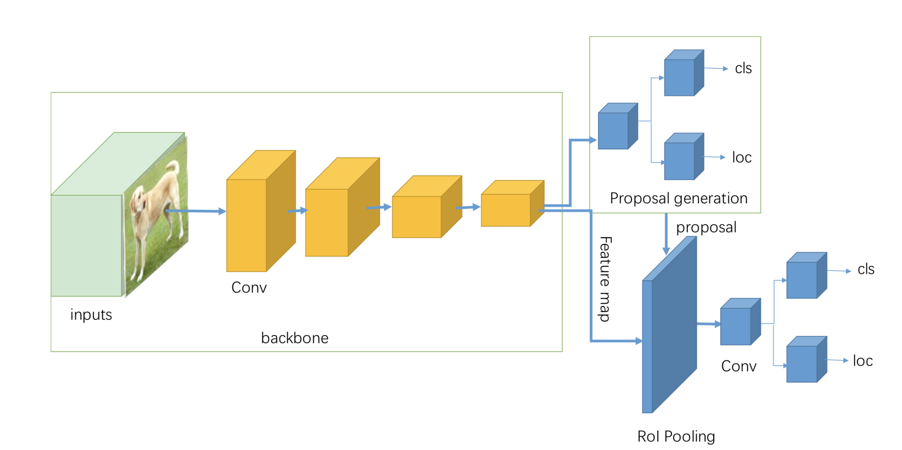
Two Stage Detectors
R-CNN
It is a region based CNN detector used for object detection. It consists of four different modules. The first module generates category-independent region proposals. The second module extracts a fixed-length feature vector from each region proposal. The third module is a set of class-specific linear SVMs to classify the objects in one image. The last module is a bounding-box regressor for precisely bounding-box prediction.

Slide 5
Fast R-CNN
Fast R-CNN feeds the region proposals to the CNN, we feed the input image to the CNN to generate a convolutional feature map. From the convolutional feature map, we extract the features from an entire input image and then by using region of interest (ROI) pooling layer, we pass them to get the fixed size features as the input of the classification to feed it to the fully connected layer.
Large amounts of time can be saved for CNN processing and large disk storage can be saved by using Fast R-CNN. It is a one-stage end-to-end training process using a multi-task loss on each labeled RoI to jointly train the network. For fast detection, the author uses truncated SVD, which accelerates the forward pass of computing the fully connected layers.

Slide 6
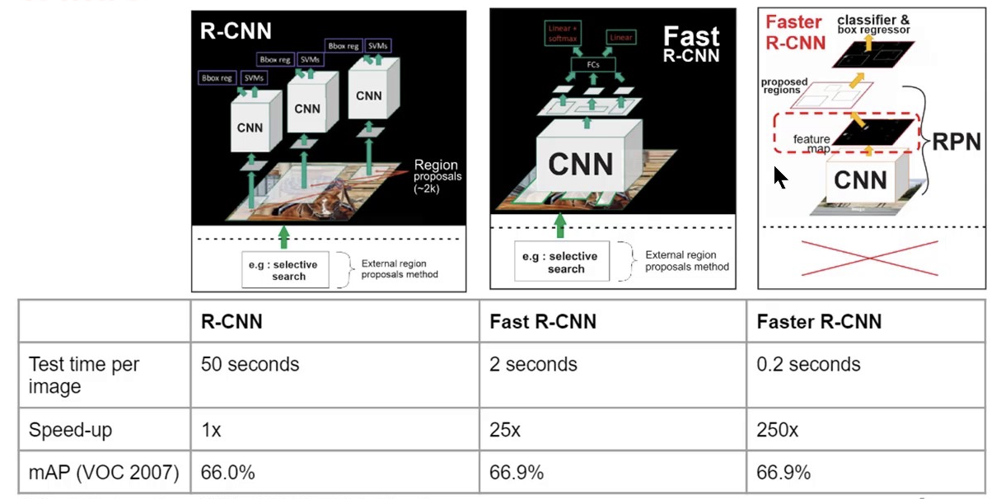
Comparison of different R-CNN’s:

Slide 7
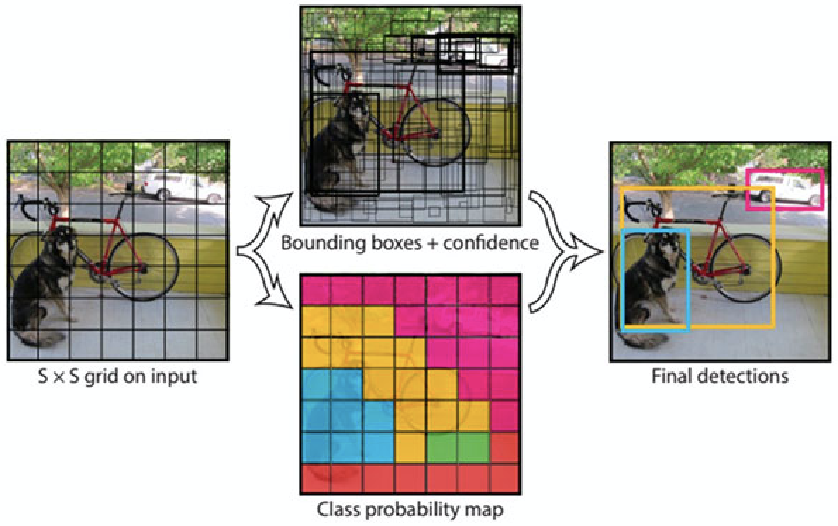
One Stage Detectors:
YOLO
You Only Look Once(YOLO) is mainly used in real-time detection of full images and webcam. Primarily, because it predicts less than 100 bounding boxes per image while Fast R-CNN uses selective search which predicts 2000 region proposals per image.
Secondly, it can also extract features from the given images and it will directly predict class probabilities and bounding boxes which is considered as a regression problem. YOLO network runs at 45 frames per second with no batch processing.

Slide 8
YOLOv2
An improvised version of YOLO is YOLOv2. YOLOv2 adds a Batch Normalization layer ahead of each convolutional layer which accelerates the network to get convergence and helps regularize the model.
High Resolution Classifier
Uses Convolutional with anchor boxes
It predicts the size and aspect ratio of anchor boxes using dimension clusters.
Fine-Grained Features
Multi-Scale Training

Slide 9
YOLOv3
It is an improvised version of YOLOv2.
Firstly, it uses multi-label classification to adapt to more complex datasets, which contain many overlapping labels.
Uses three different scale feature maps to predict the bounding box. The last convolutional layer predicts a 3-d tensor encoding class predictions, objectness and bounding box.
Third, YOLOv3 proposes a deeper and robust feature extractor, called Darknet-53, inspired by ResNet.
Due to the advantages of multi-scale predictions, YOLOv3 can detect small objects even more but has comparatively worse performance on medium and larger sized objects.

Slide 10
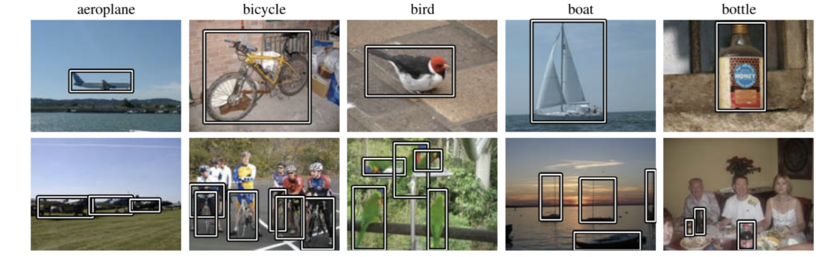
Datasets and Metrics
PASCAL VOC dataset
It contains 20 object categories (such as person, bicycle, bird, bottle, dog, etc.) spread over 11,000 images. The 20 categories can be considered as 4 main branches-vehicles, animals, household objects and people.
For the VOC2007 criteria, the interpolated average precision was used to evaluate both classification and detection. Sample images from a pascal dataset are provided below.

Slide 11
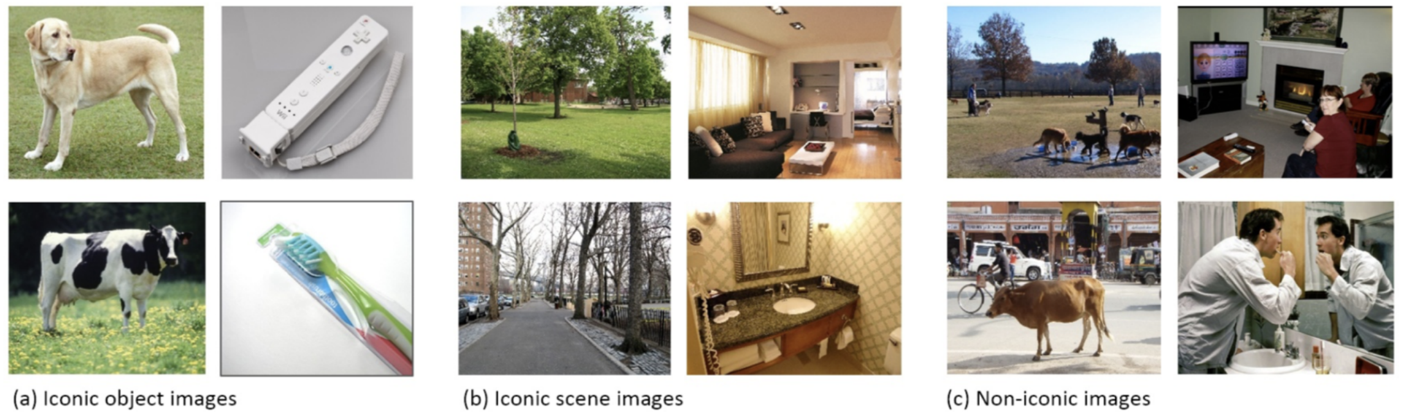
MS COCO benchmark
The Microsoft Common Objects in Context (MS COCO) dataset for detecting and segmenting objects found in everyday life in their natural environments contains 91 common object categories with 82 of them having more than 5,000 labeled instances. In total the dataset has 2,500,000 labeled instances in 328,000 images.

Slide 12
ImageNet benchmark
The ILSVRC task of object detection evaluates the ability of an algorithm to name and localize all instances of all target objects present in an image. ILSVRC2014 has 200 object classes and nearly 450k training images, 20k validation images and 40k test images.
Open Images V5
Open Images is a dataset of 9.2M images annotated with image-level labels, object bounding boxes, object segmentation masks, and visual relationships. Open Images V5 contains a total of 16M bounding boxes for 600 object classes on 1.9M images, which makes it the largest existing dataset with object location annotations.

Slide 13
Analysis of general image object detection methods
Increasing localization accuracy
Solving negatives-positives imbalance issue
Improving post-processing NMS methods
Combining one-stage and two-stage detectors to make good results
Complicated scene solutions
Anchor-free
Training from scratch
Designing new architecture
Speeding up detection
Achieving Fast and Accurate Detections

Slide 14
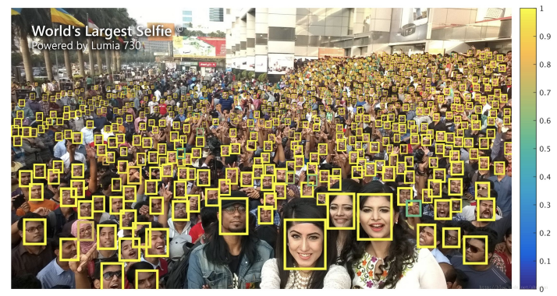
Applications
Security field
Face detection
Pedestrian detection
Anomaly detection
Military field
Remote sensing object detection
Transportation field
License plate recognition
Autonomous driving
traffic sign recognition
Medical field
Computer Aided Diagnosis (CAD) systems

Slide 15
Conclusion
Object detection has been growing rapidly with the continuous upgrading of powerful computing equipment. For achieving high accuracy and efficiency detectors is the ultimate goal of this task.
With the increasingly powerful object detectors in the security field, military field, transportation field, medical field, and life field, the application of object detection is gradually extensive.
Although the achievement of this domain has been effective recently, there is still much room for further development.

Slide 16
References:
Article Link: https://arxiv.org/pdf/1907.09408.pdf
Thank you

